Slide 1
Unit 6: Fuzzy Logic
Lecture 1

Slide 2
Fuzzy Logic:
Fuzzy logic is an approach to computing based on “degree of truth” rather than the usual “true or false” (1 or 0) Boolean logic on which the modern computer is based.
Fuzzy Logic (FL) is a method of reasoning that resembles human reasoning. The approach of FL imitates the way of decision making in humans that involves all intermediate possibilities between digital values YES and NO.
The conventional logic block that a computer can understand takes precise input and produces a definite output as TRUE or FALSE, which is equivalent to human’s YES or NO.
The inventor of fuzzy logic, observed that unlike computers, the human decision making includes a range of possibilities between YES and NO, such as:

Slide 3
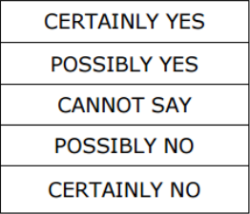
The fuzzy logic works on the levels of possibilities of input to achieve the definite output.

Slide 4
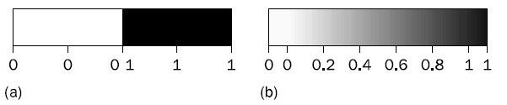
Why Fuzzy Logic?
Unlike two-valued Boolean logic, fuzzy logic is multi-valued. It deals with degrees of membership and degrees of truth.
Fuzzy logic uses the continuum of logical values between 0 (completely false) and 1 (completely true). Instead of just black and white, it employs the spectrum of colors, accepting that things can be partly true and partly false at the same time.
As can be seen in Figure below, fuzzy logic adds a range of logical values to Boolean logic.
Fig: Range of logical values in Boolean and fuzzy logic: (a) Boolean logic; (b) multi-valued logic

Slide 5
Fuzzy logic is useful for commercial and practical purposes.
It can control machines and consumer products.
It may not give accurate reasoning, but acceptable reasoning.
Fuzzy logic helps to deal with the uncertainty in engineering.

Slide 6
Fuzzy sets:
The concept of a set is fundamental to mathematics. For example, car indicates the set of cars. When we say a car, we mean one out of the set of cars. Let X be a classical (crisp) set and x an element.
Then the element x either belongs to X (x Ɛ X) or does not belong to X.
That is, classical set theory imposes a sharp boundary on this set and gives each member of the set the value of 1, and all members that are not within the set a value of 0.
This is known as the principle of dichotomy. Crisp set theory is governed by a logic that uses one of only two values: true or False.

Slide 7
The basic idea of the fuzzy set theory is that an element belongs to a fuzzy set with a certain degree of membership.
Thus, a proposition is not either true or false, but may be partly true (or partly false) to any degree. This degree is usually taken as a real number in the interval [0, 1].
The classical example in the fuzzy set theory is tall men. The elements of the fuzzy set ‘tall men’ are all men, but their degrees of membership depend on their height, as shown in Table 1.
Suppose, for example, Mark at 205cm tall is given a degree of 1, and Peter at 152cm is given a degree of 0.
All men of intermediate height have intermediate degrees. They are partly tall.

Slide 8
Obviously, different people may have different views as to whether a given man should be considered as tall. However, our candidates for tall men could have the memberships presented in Table 1.
It can be seen that the crisp set asks the question, ‘Is the man tall?’ and draws a line at, say, 180 cm. Tall men are above this height and not tall men below. In contrast, the fuzzy set asks, ‘How tall is the man?’
The answer is the partial membership in the fuzzy set, for example, Tom is 0.82 tall. A fuzzy set is capable of providing a graceful transition across a boundary, as shown in Figure 2.
We might consider a few other sets such as ‘very short men’, ‘short men’, ‘average men’ and ‘very tall men’.

Slide 9
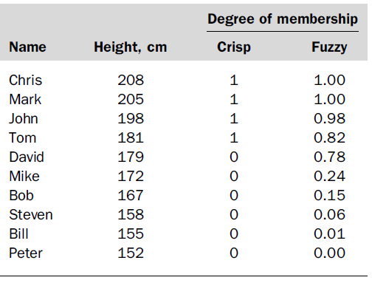
In Figure 2 the horizontal axis represents the universe of discourse –the range of all possible values applicable to a chosen variable.
In our case, the variable is the human height. According to this representation, the universe of men’s heights consists of all tall men.

Slide 10
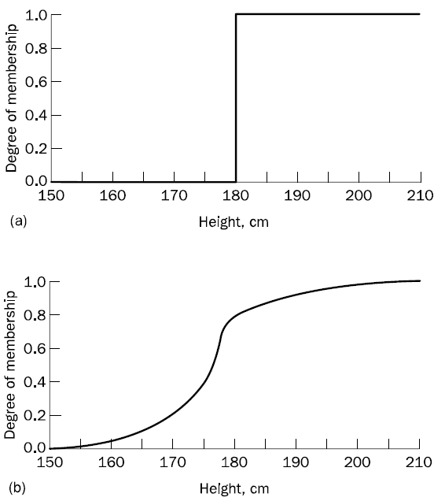
Figure 2 : Crisp (a) and fuzzy (b) sets of ‘tall men’

Slide 11
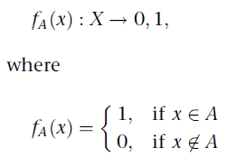
A fuzzy set can be simply defined as a set with fuzzy boundaries. Let X be the universe of discourse and its elements be denoted as x. In classical set theory, crisp set A of X is defined as function f_{A}(x) called the characteristic function of A:
This set maps universe X to a set of two elements. For any element x of universe X, characteristic function f_{A}(x) is equal to 1 if x is an element of set A, and is equal to 0 if x is not an element of A.
In the fuzzy theory, fuzzy set A of universe X is defined by function µA(x) called the membership function of set A

Slide 12
Membership Functions
Membership functions allow you to quantify linguistic term and represent a fuzzy set graphically. A membership function for a fuzzy set A on the universe of discourse X is defined as µA:X → [0,1]. Here, each element of X is mapped to a value between 0 and 1.
It is called membership value or degree of membership. It quantifies the degree of membership of the element in X to the fuzzy set A.
• x axis represents the universe of discourse.
• y axis represents the degrees of membership in the [0, 1] interval.

